Slide 1
Demonstration of Using Python for G3 Data Processing
Robert Shaw

Slide 2
Messages
Script written in Python to carry out pre-processing of G3 data.
Outputs two .csv files for data analysis:
Spotfire – data visualisation
SIMCA – PCA
Run on some historical Ticagrelor data as proof of concept.

Slide 3
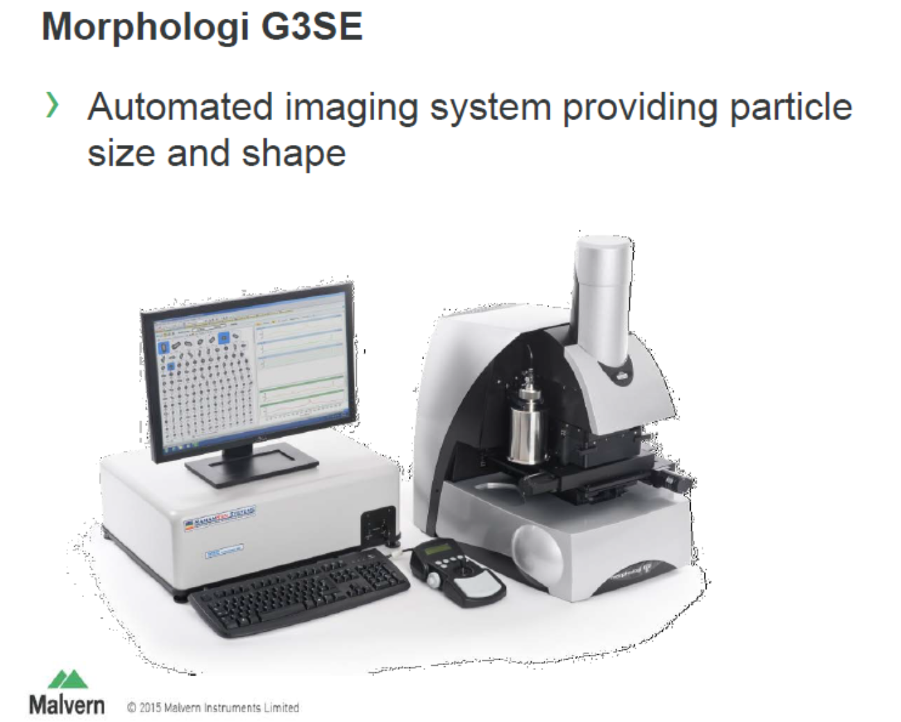

Slide 4
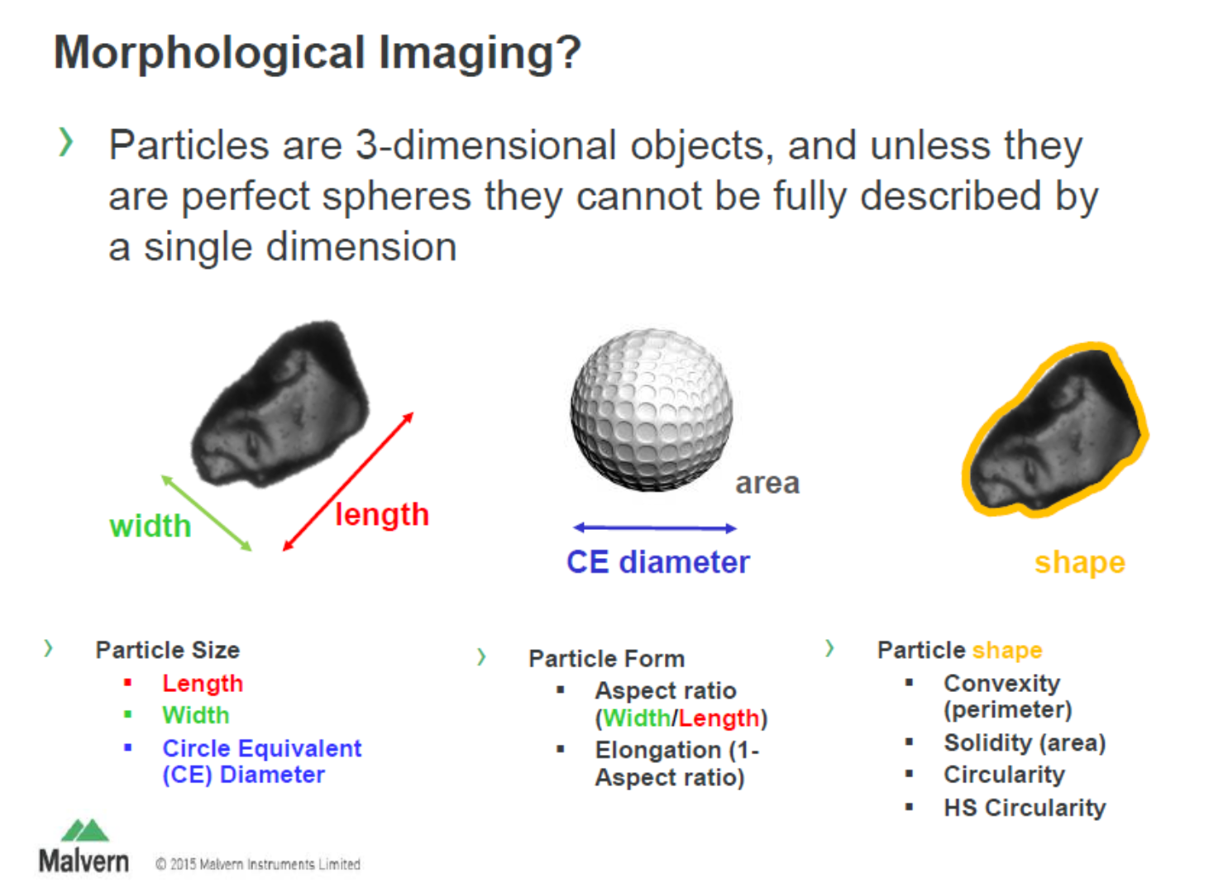

Slide 5
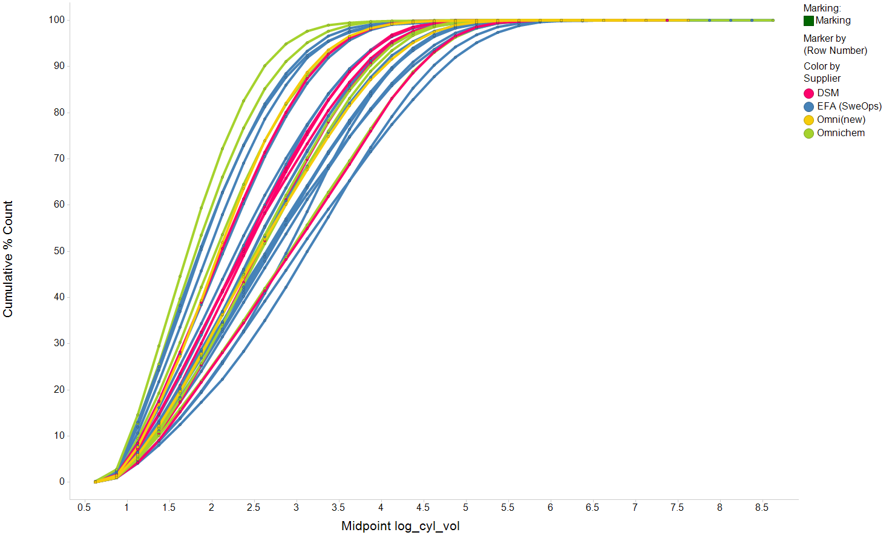
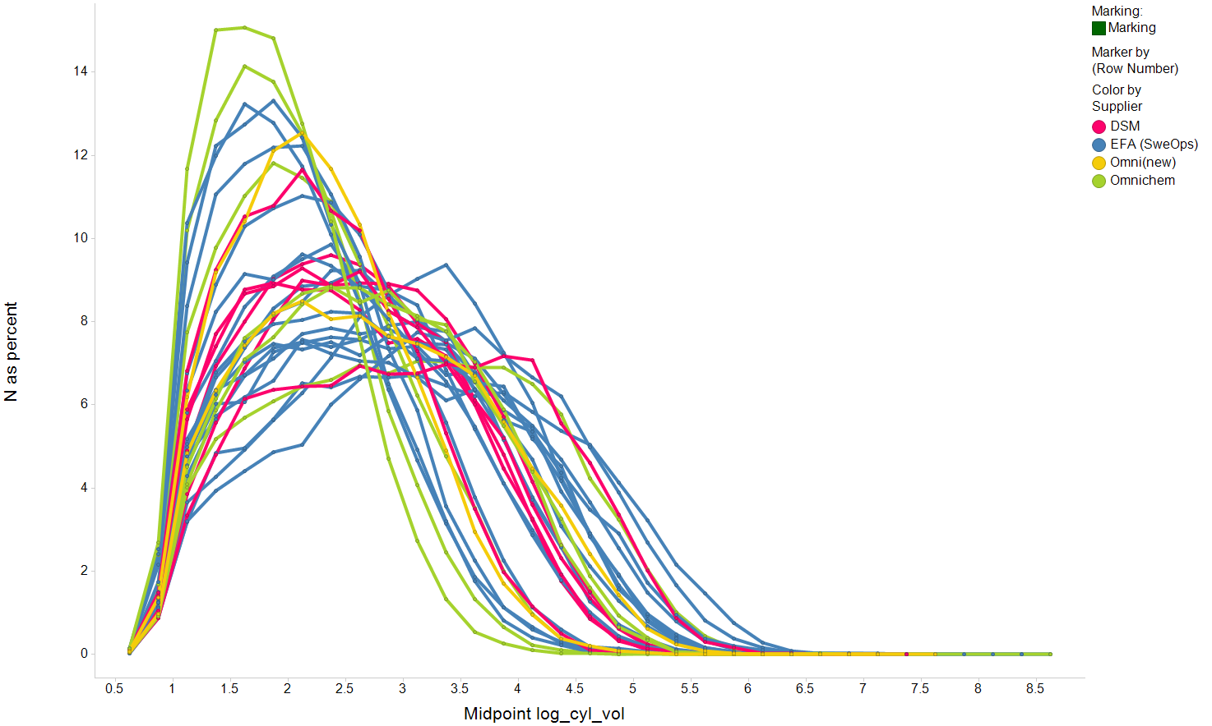
Distribution of Particle Size Per Bin (%)
N as percent vs. Midpoint log_cyl_vol

Slide 6
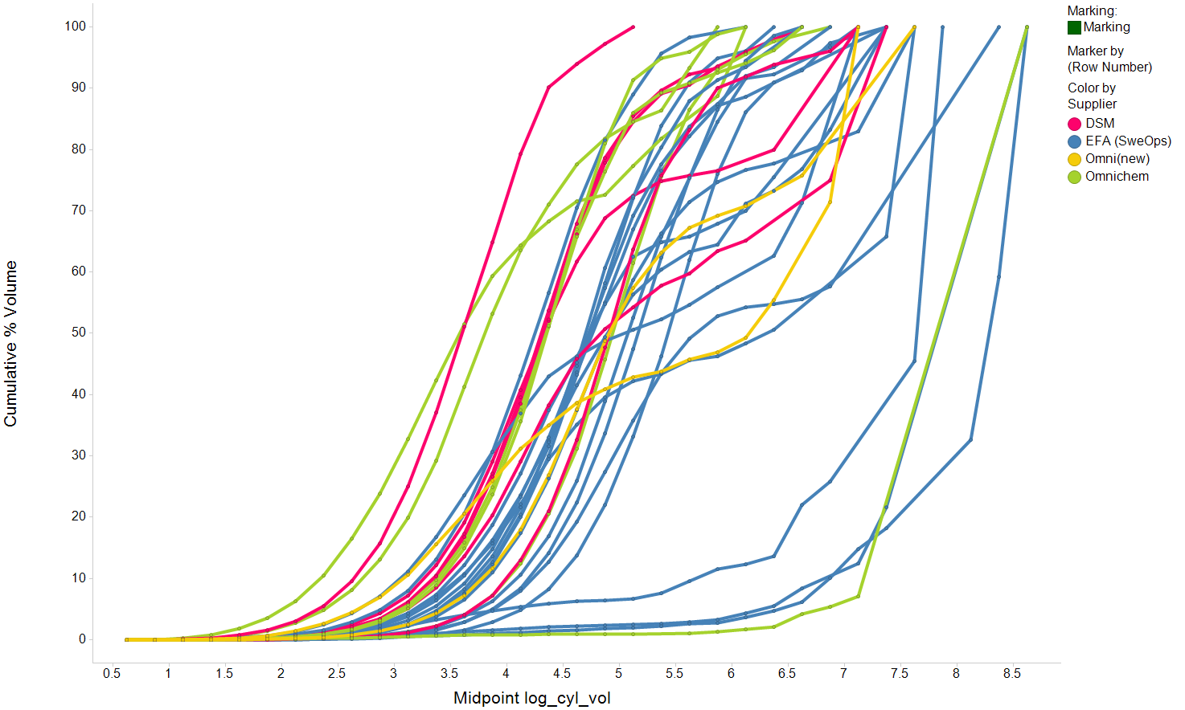
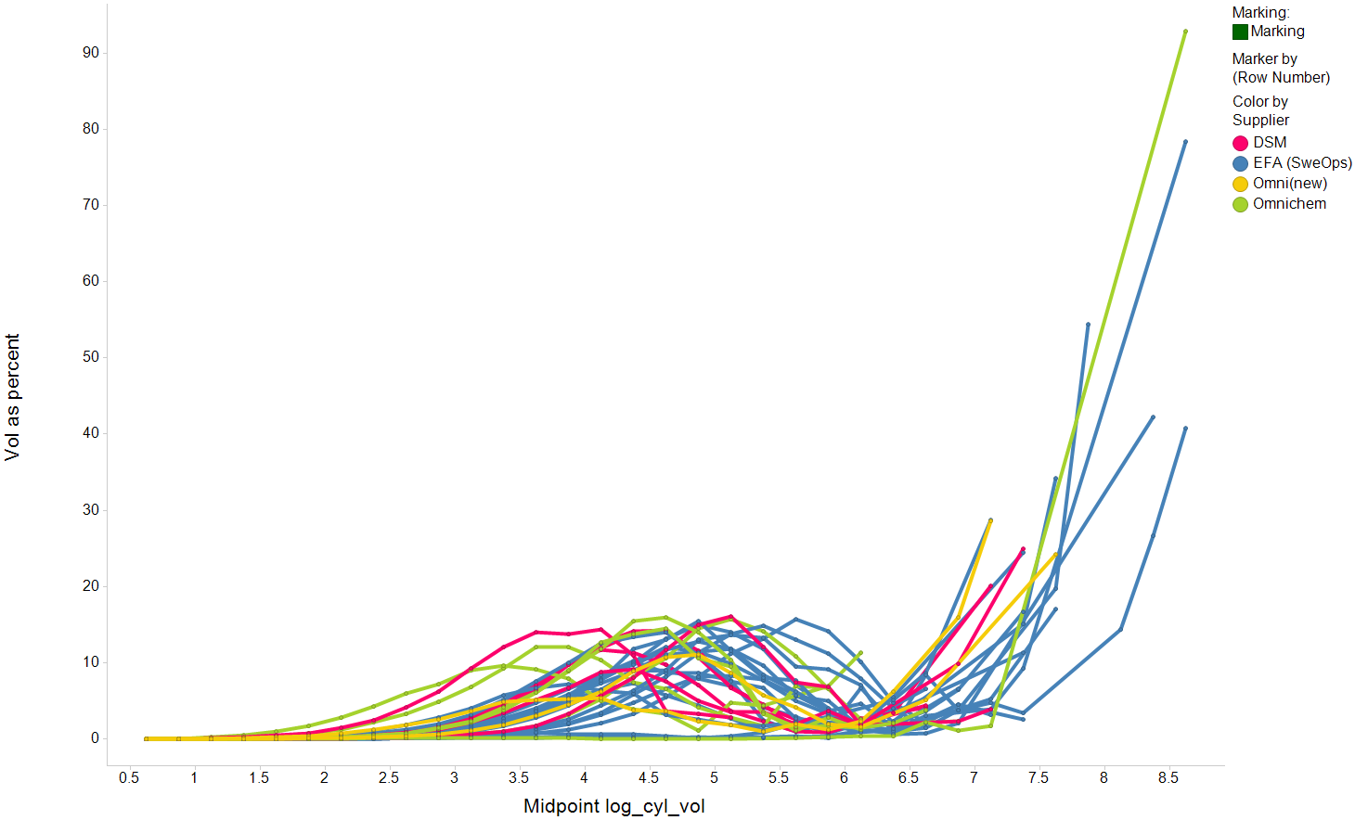
Distribution of Particle Volume Per Bin (%)
Vol as percent vs. Midpoint log_cyl_vol

Slide 7
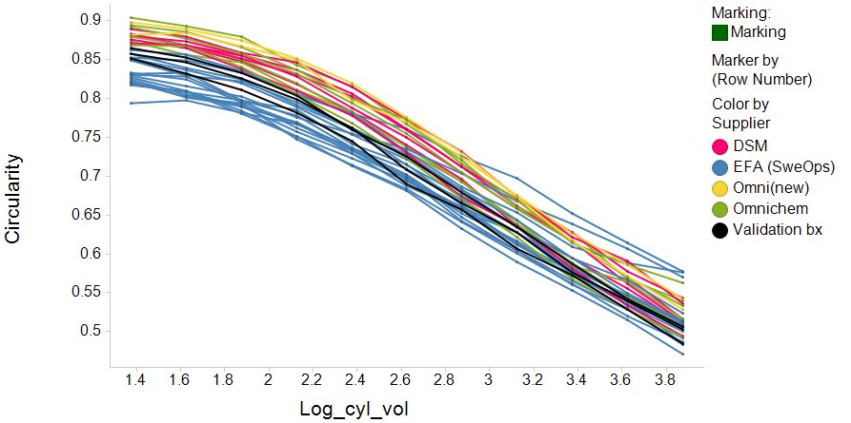
Circularity
Circularity vs. Log_cyl_vol

Slide 8
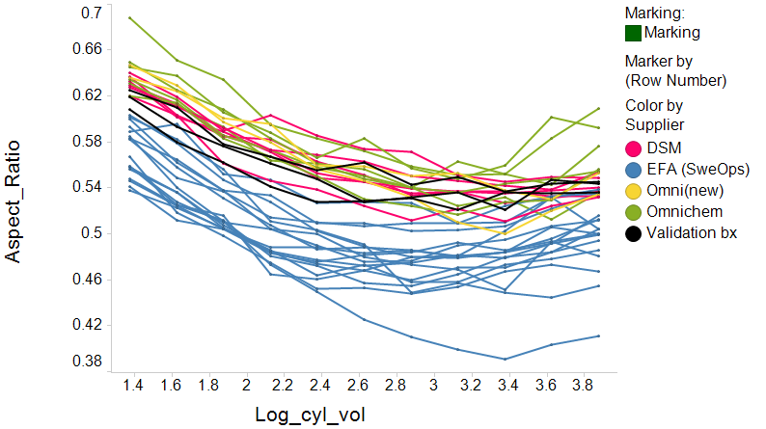
Aspect Ratio
Aspect_Ratio vs. Log_cyl_vol

Slide 9
Principal Components Analysis on Shape Parameters

Slide 10
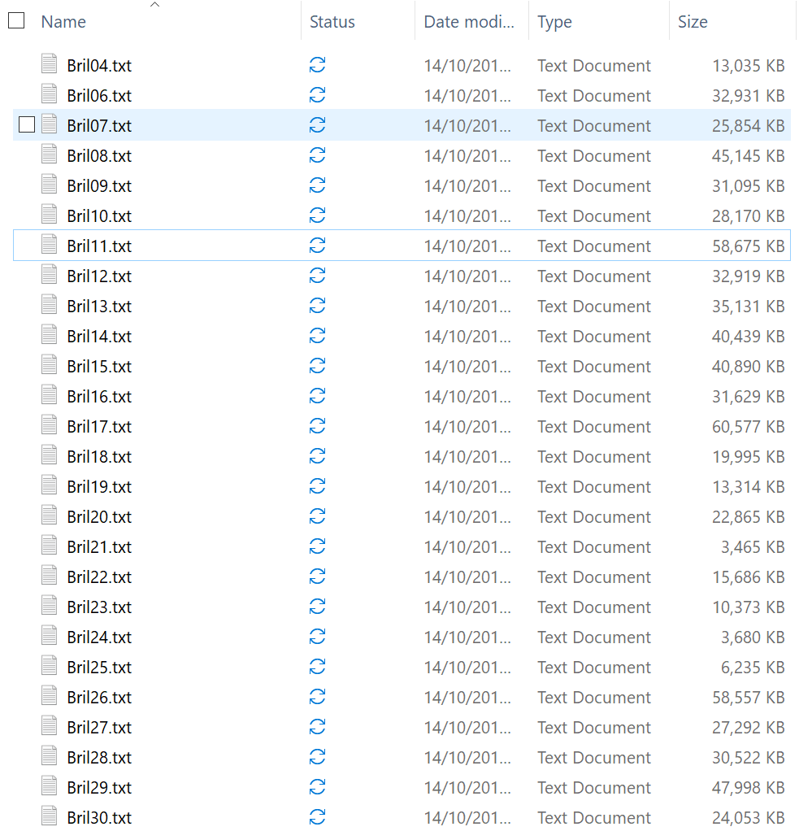
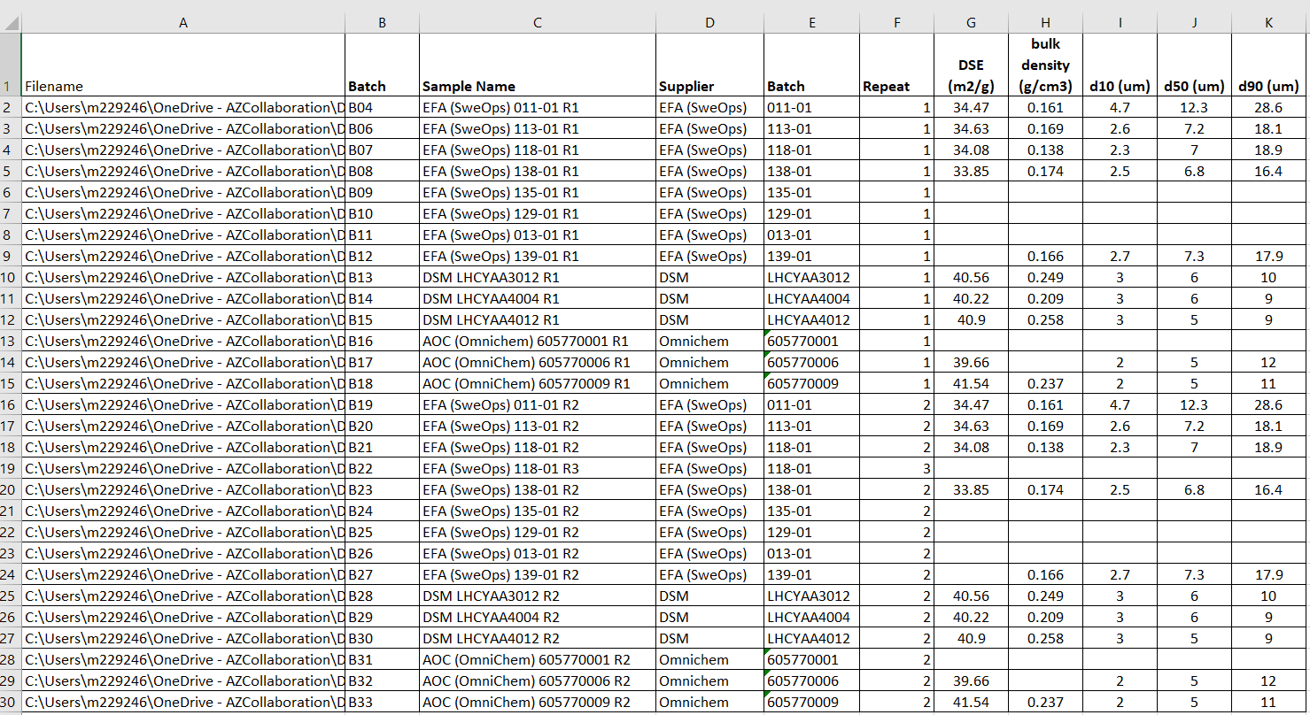
Organise Files from G3
Created Excel file with pathname, unique identifier and meta data

Slide 11
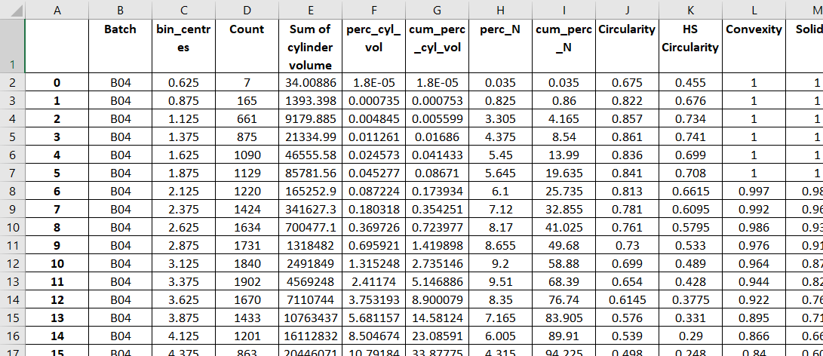
Spotfire-Ready Output File
Python Steps:
Loop through G3 text files:
Read in a random sample of 20K particles
Stack in to one single file
Keep meta data
Output raw data to bins – based on cylindrical volume
Calculate summary Statistics:
% volume, # particles
Cumulative % volume per bx
Cumulative % # particles per bx
Median(shape parameters)

Slide 12
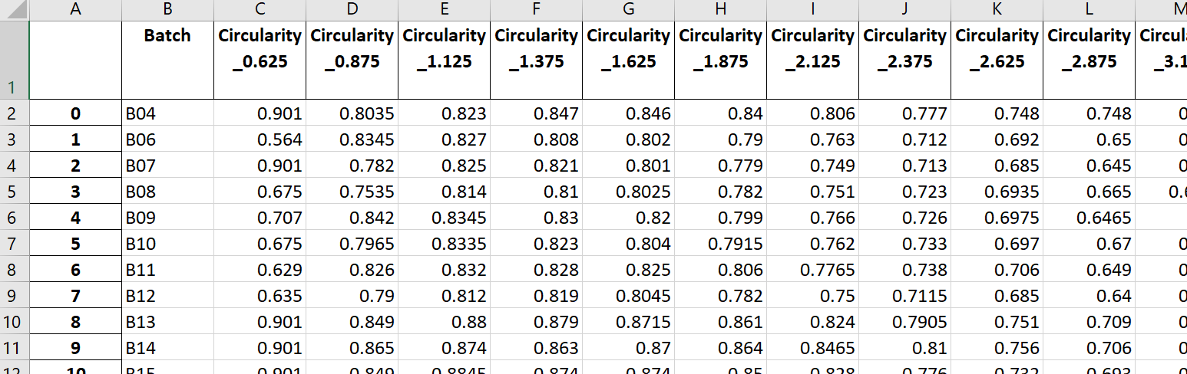
SIMCA-Ready Output File
Python Steps:
Pivot data for each shape parameter
Merge together for all shape parameters & with meta data

